Slide 1
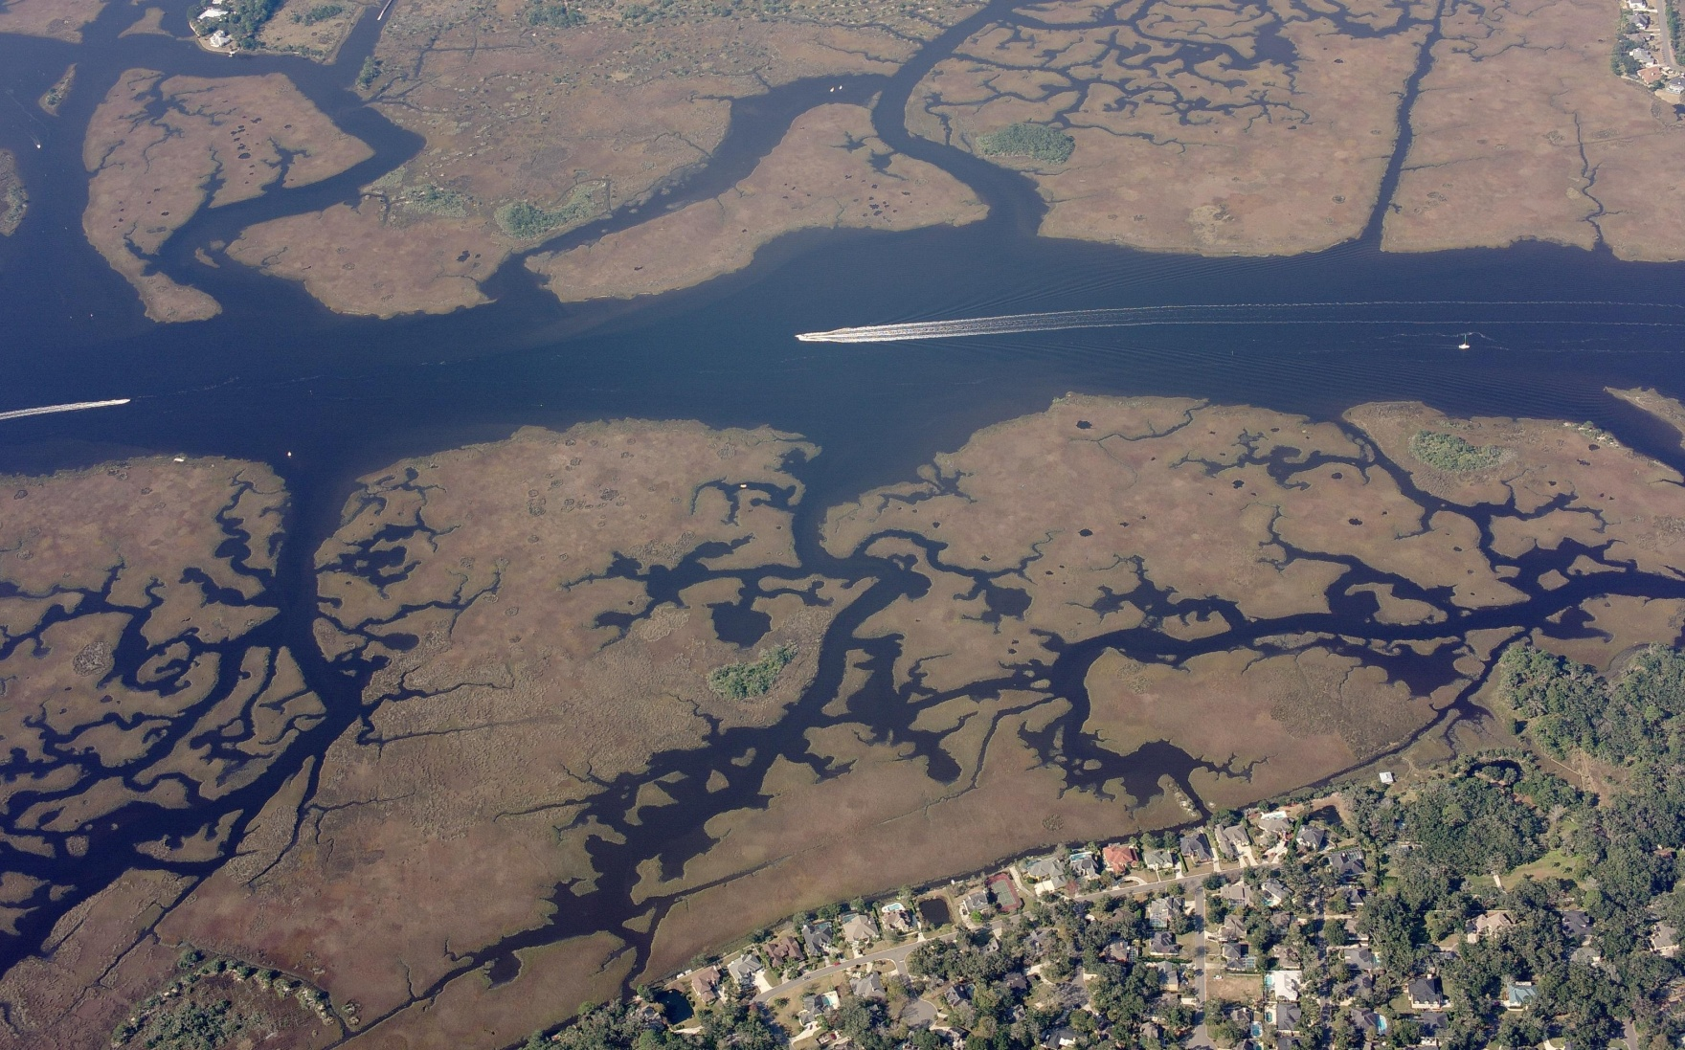
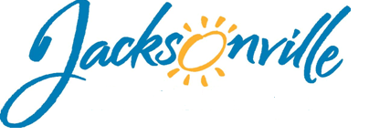
2016 Florida Inland Navigation District Proposed Applications

Slide 2
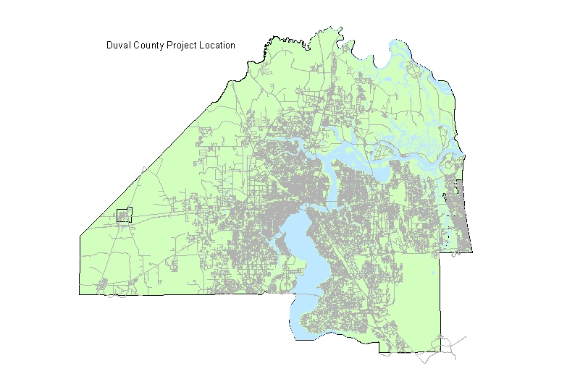
Location of 2016
Proposed FIND Projects
Half Moon Island
Boat Ramp & Park
$2,048,486
Northshore Kayak Launch
$152,875
Charles Reese
Fishing Pier
$307,506
Southbank Riverwalk
Floating Dock
$166,237
Construction Phase
Design Phase
Notes:
Just to start off with a county map that shows all the locations of all of the this years projects.
Duval County is 918 sq. miles with 1139 miles of shoreline. Jacksonville has nearly 400 city parks –88 of those are waterfront.
When Mayor Brown was elected, he announced his River Access Initiative to respond to the need for more economical ways for residents to experience Jacksonville's waterways.
Several of these projects reflect that initiative
All 2014 applications are for construction phase projects.

Slide 3
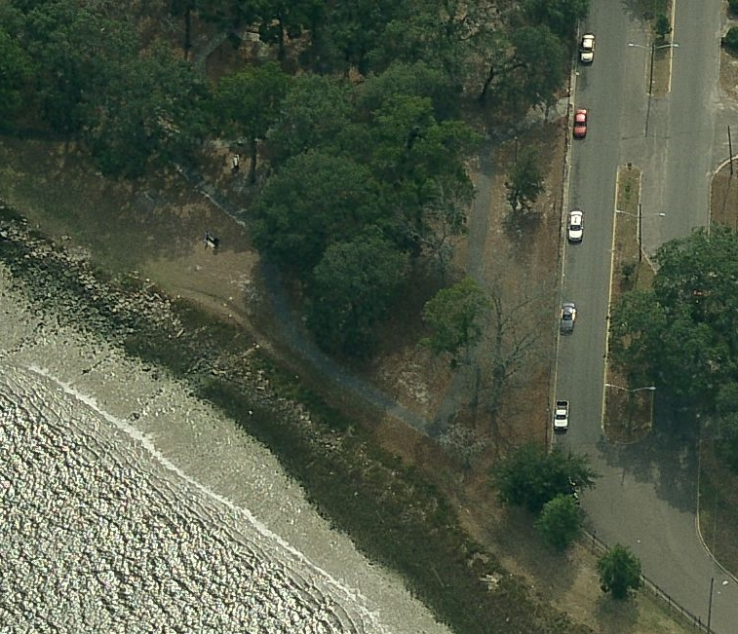
Northshore Park
Kayak Launch
Council District 8
Phase 2 Construction Cost: $152,875
Scope: Stabilize shoreline for kayak launch with ADA access route
Stabilized
Kayak Launch
Accessible Route
Grant for design received in 2013
This is the final grant cycle which we can pursue project construction

Slide 4
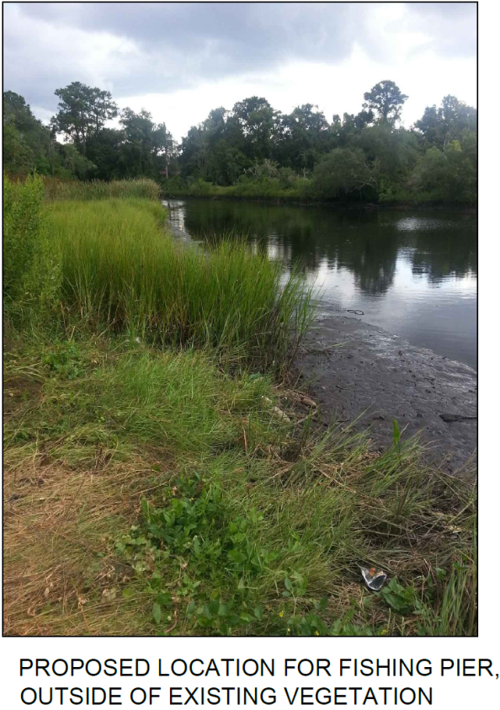
Charles Reese Memorial Park Fishing Pier
& Kayak Launch
Council District 10
Phase 2 Construction Cost $307,506
Scope: Build a 100 ft. fishing pier & convert existing boat ramp to kayak launch
Grant for design received in 2013
This is the final grant cycle which we can pursue project construction

Slide 5
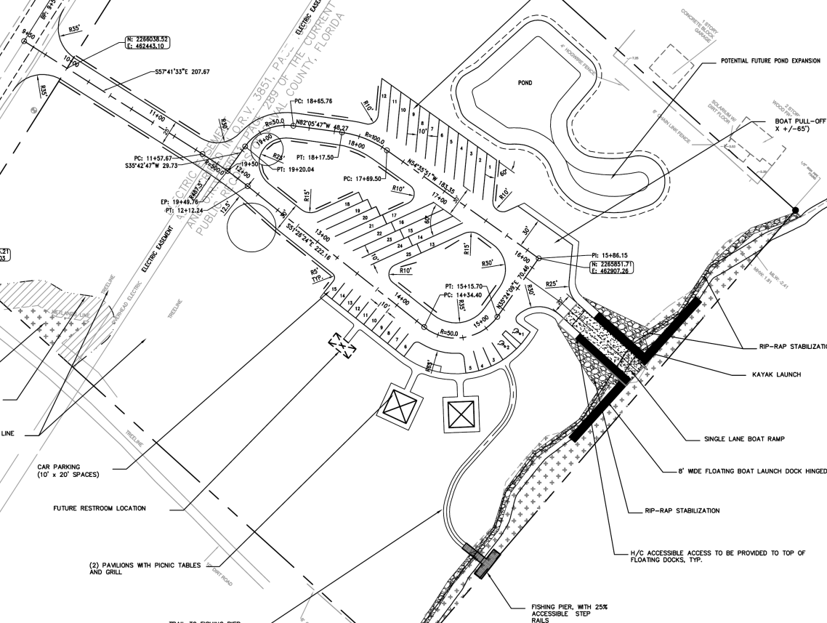
Half Moon Island Preserve Boat Ramp & Park Development Phase 2A
Council District 2
Phase 2A Construction Cost
$2,048,486
2A Scope: Boat ramp, floating dock, facility entrance and parking, shoreline revetment, site clearing/grading and stormwater pond
__________________________
Phase 2B (Future Phase)
Construstion Costs $484,419
2B Scope: Fishing platform, shelters, floating dock
Grant for design received in 2013
This is the final grant cycle which we can pursue project construction

Slide 6
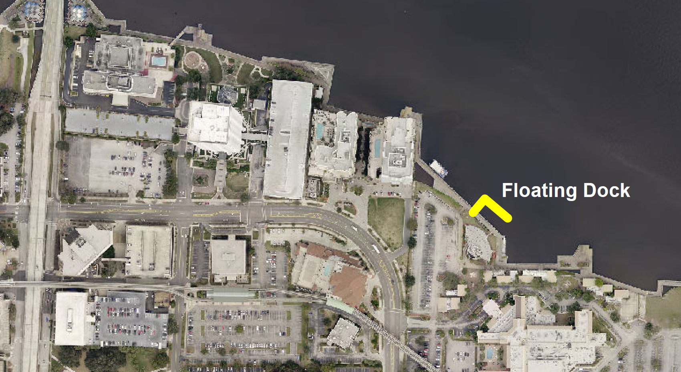
Southbank Riverwalk
Floating Dock
Council District 5
Phase 1 Design Cost: $166,237
Scope: Design and permit a 120 ft. floating dock near the Chart House

Slide 7
Funding Breakdown
for Proposed Projects
Anticipated total 2016 FIND dollars | $1,400,000
Anticipated Atlantic Beach request for FIND dollars | $250,000
Anticipated FIND dollars available for COJ | $1,150,000
Anticipated COJ match | $1,525,104
Anticipated Total Cost | $2,675,104

